Slide 1


Slide 2
Khurram Khawer 2017-EE-380
Data Structure and Algorithm

Slide 3


Raspberry PI

Slide 4


Types of Raspberry PI
Introduction
The Raspberry Pi is a credit-card sized computer that plugs into your TV and a keyboard.
It’s a capable little PC which can be used for many of the things that your desktop PC does.
Created by Eben Upton CEO of Raspberry Pi Foundation
Raspberry Pi Foundation goal is to see it being used by kids all over the world to learn programming.

Slide 5
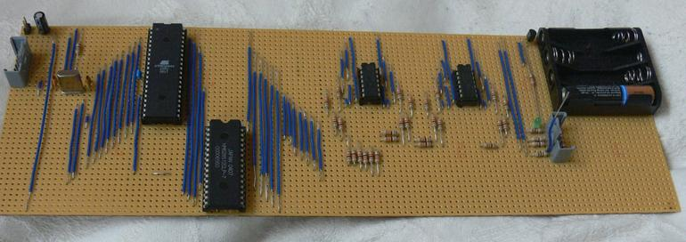
Types of Raspberry PI
history
The 1st Prototype was developed in 2006.
Officially launched in 2012
The machine at that time had the advantage to be manually assembled

Slide 6
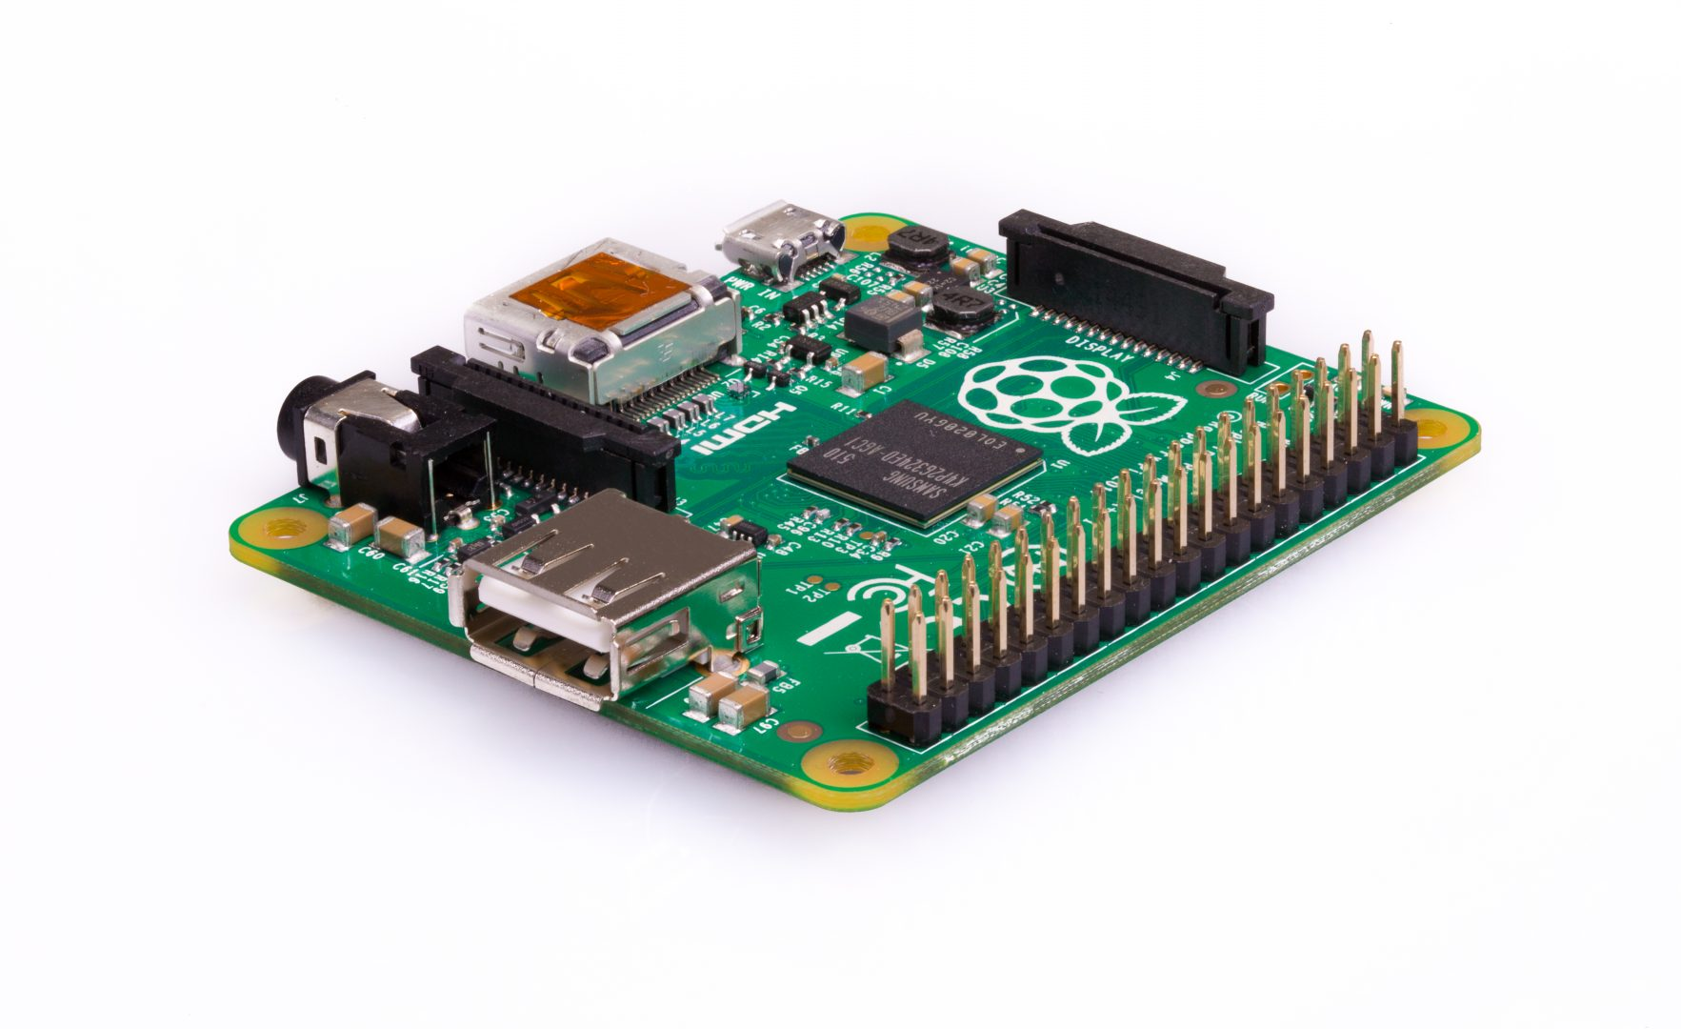
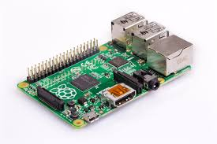
Types
Raspberry PI Model A+
Raspberry PI Model B+

Slide 7
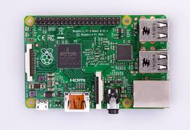
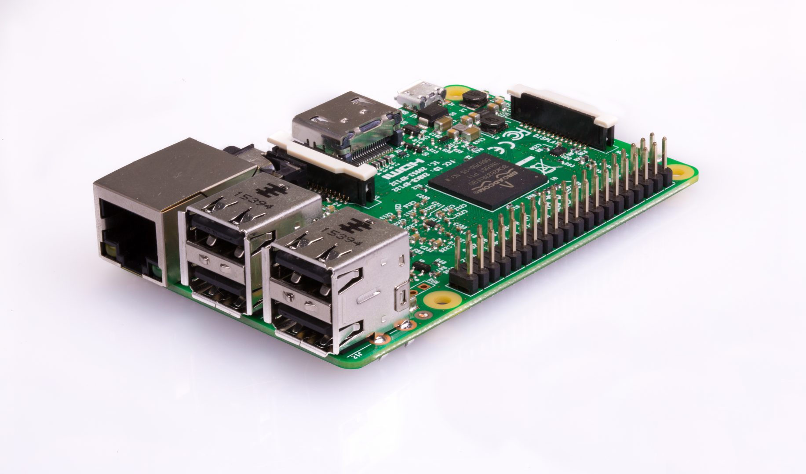
Types
Raspberry PI 2 Model B
Raspberry PI 3 Model B

Slide 8
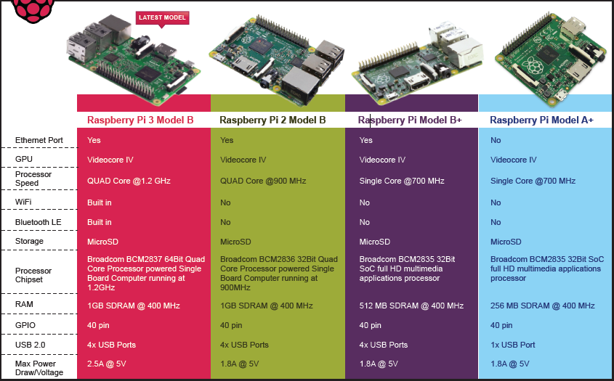
Comparision

Slide 9
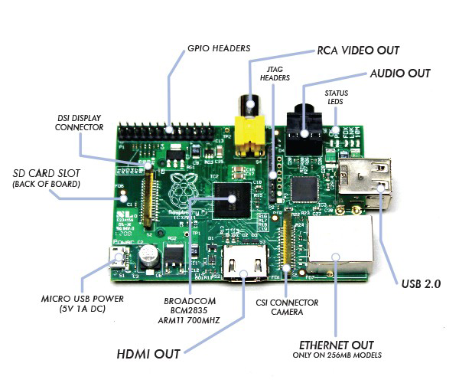
Parts

Slide 10
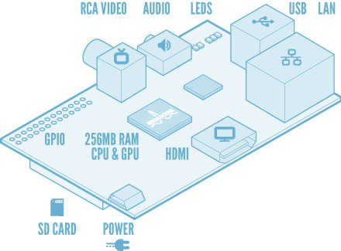

Slide 11
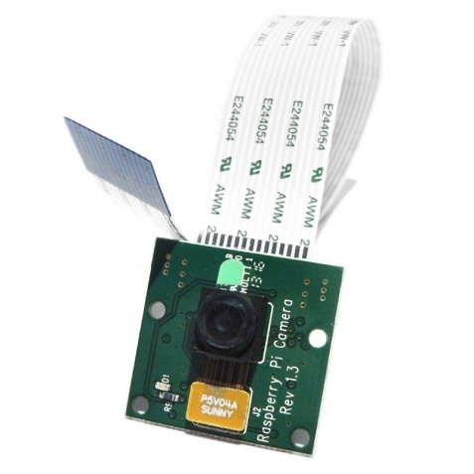
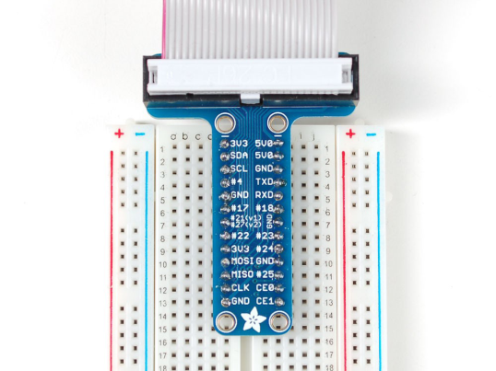
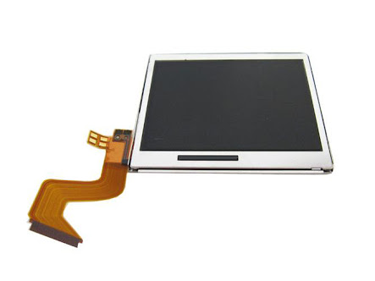
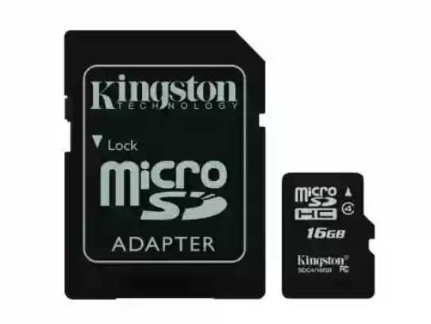
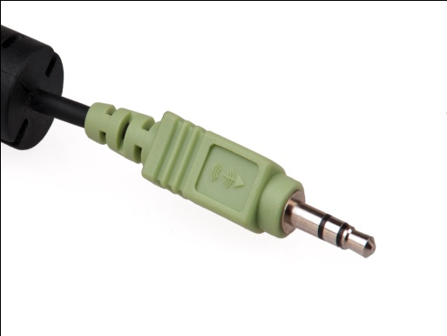
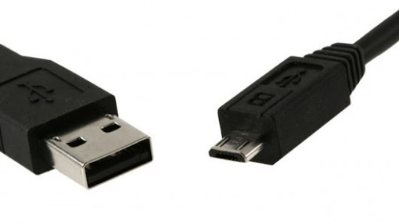
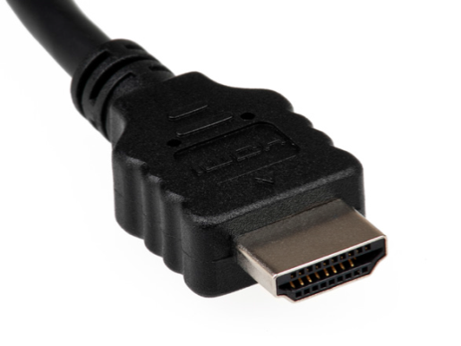
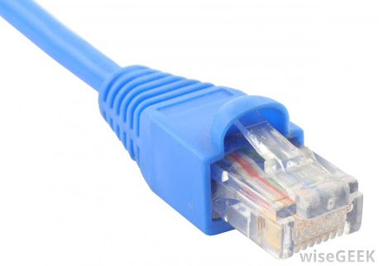
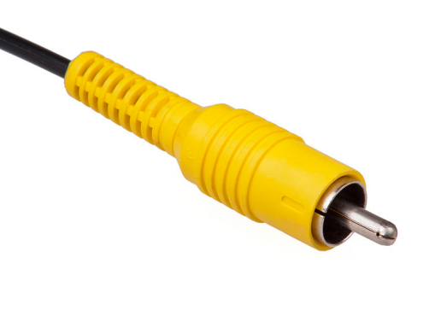
GPIO
DSI LCD with connector
CSI camera with connector
SD
MicroSD
3.5mm audio jack
USB 2.0
Micro USB
Ethernet connector
RCA video connector
HDMI connector

Slide 12








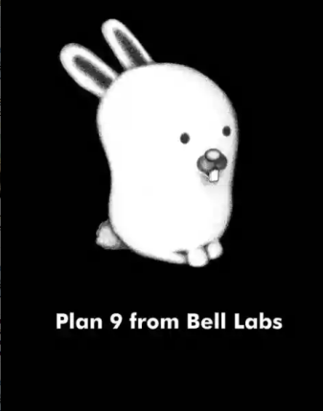



Operating systems

Slide 13


Softwares
NOOBS Software
Raspbian Software

Slide 14
Set-Up
SD card (Minimum size 4 Gb, recommended 8 Gb)
HDMI to HDMI / DVI lead
RCA video lead (If you are not using the HDMI output)
Keyboard and Mouse (USB 2.0)
Ethernet network cable (optional)
Power adapter (Micro USB)
Audio lead

Slide 15
Programming Languages
Python (Primary programming language)
Java
C/C++
HTML5
JavaScript
Scratch (Mathematical and computational concepts)
JQuery (JavaScript library)
Perl
Erlang

Slide 16
Applications

Slide 17
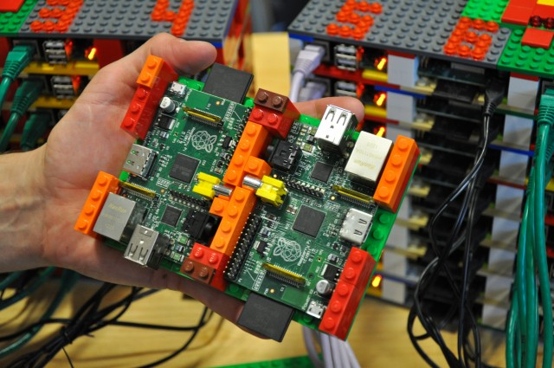
Iridis-Pi
Supercomputer.
Developed by Prof Simon Cox of the University of Southampton.
Calculating Pi was the first test.
System has 64 processors and 1TB of memory.
Each Raspberry Pi has 16 GB of SD card.

Slide 18
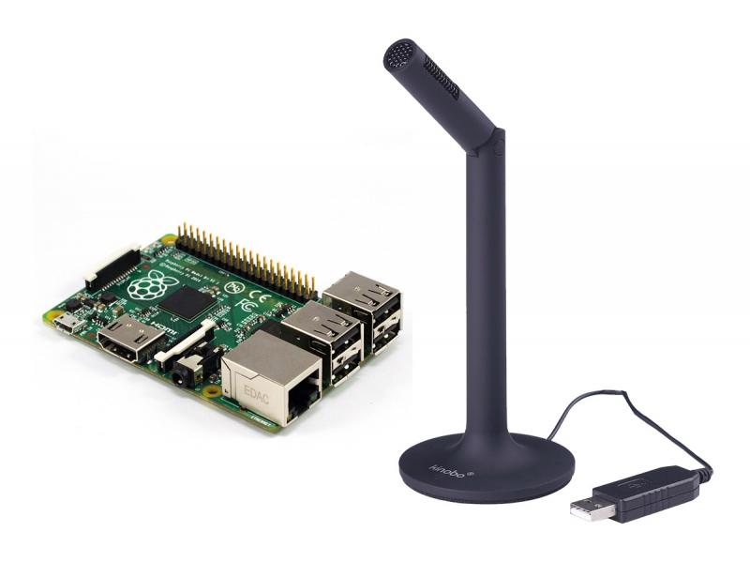
JASper
Developed by Charlie Marsh and Shubhro Saha.
Open-source platform.
Control anything with your voice.
Always listening.

Slide 19
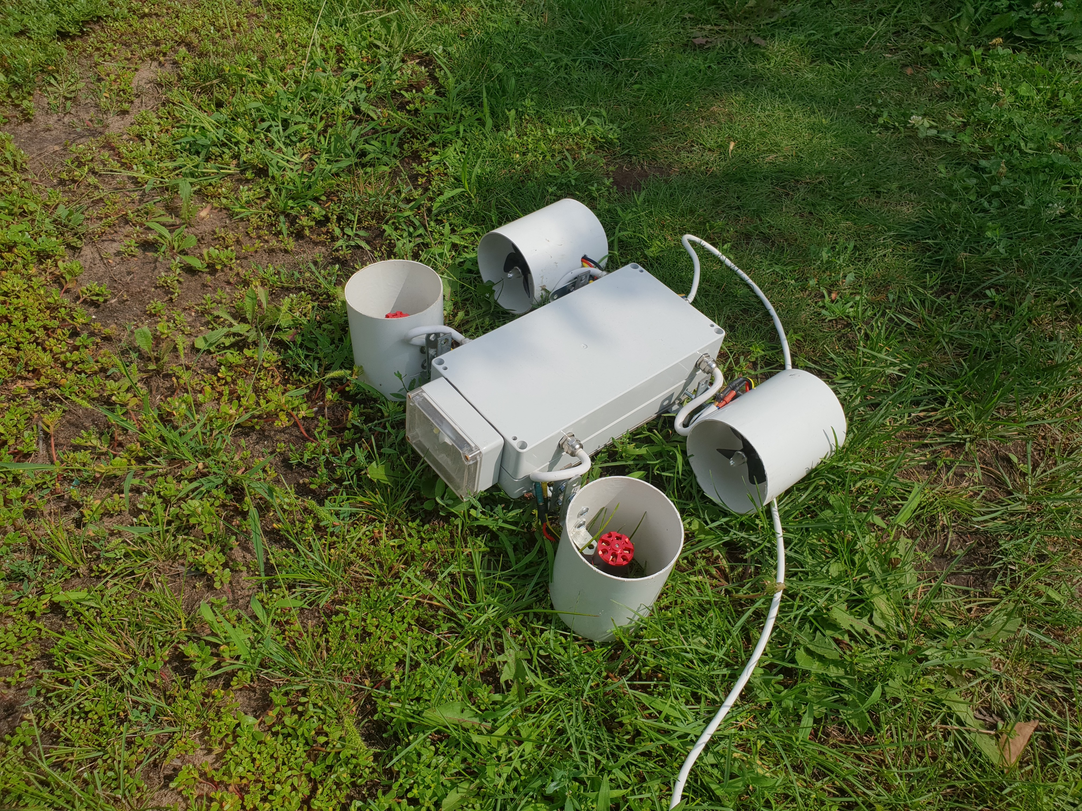
Magpi-80
Developed by Levgenii Tkachenko.
Made from Raspberry PI 3B.
An Underwater Camera Drone.

Slide 20
Other applications
Robots & Drones
Media streamer
Home automation
Cosmic computer
Tablet computer
Game stations

Slide 21
What makes it special?
Low price
Open-source
Low power consumption
Small size
Over clocking
No need of heat-sink
Connect to old analogue TV
Supports 1080p HD video

Slide 22
Newest Model
Raspberry Pi 3 Model B+
A 1.4GHz 64-bit quad-core ARM Cortex-A53 CPU
A Miniature PC
Dual-band 802.11ac wireless LAN and Bluetooth 4.2
Faster Ethernet (Gigabit Ethernet over USB 2.0)
Power-over-Ethernet support (with separate PoE HAT)
Improved PXE network and USB mass-storage booting
Improved thermal management

Slide 23
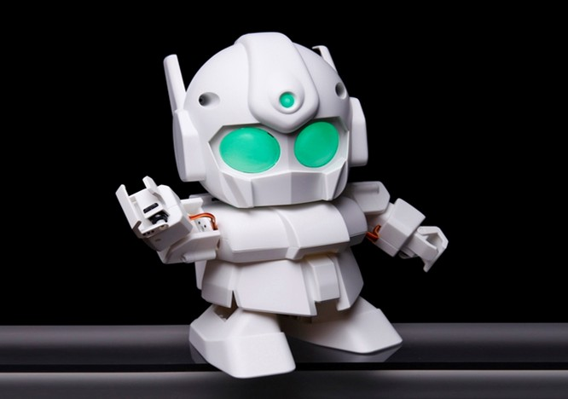
Any Questions???

Slide 24


